Slide 1
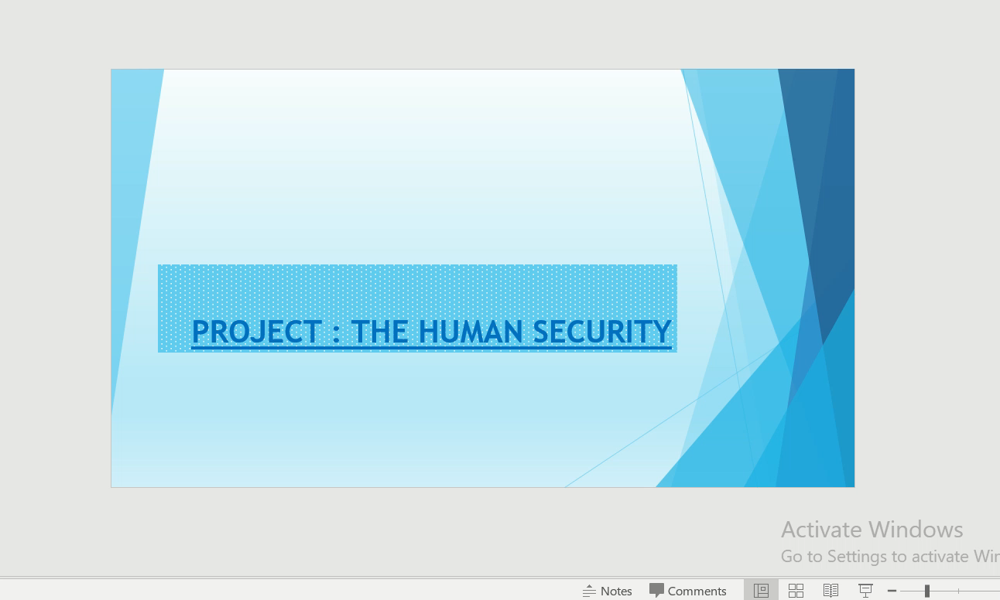

Slide 2
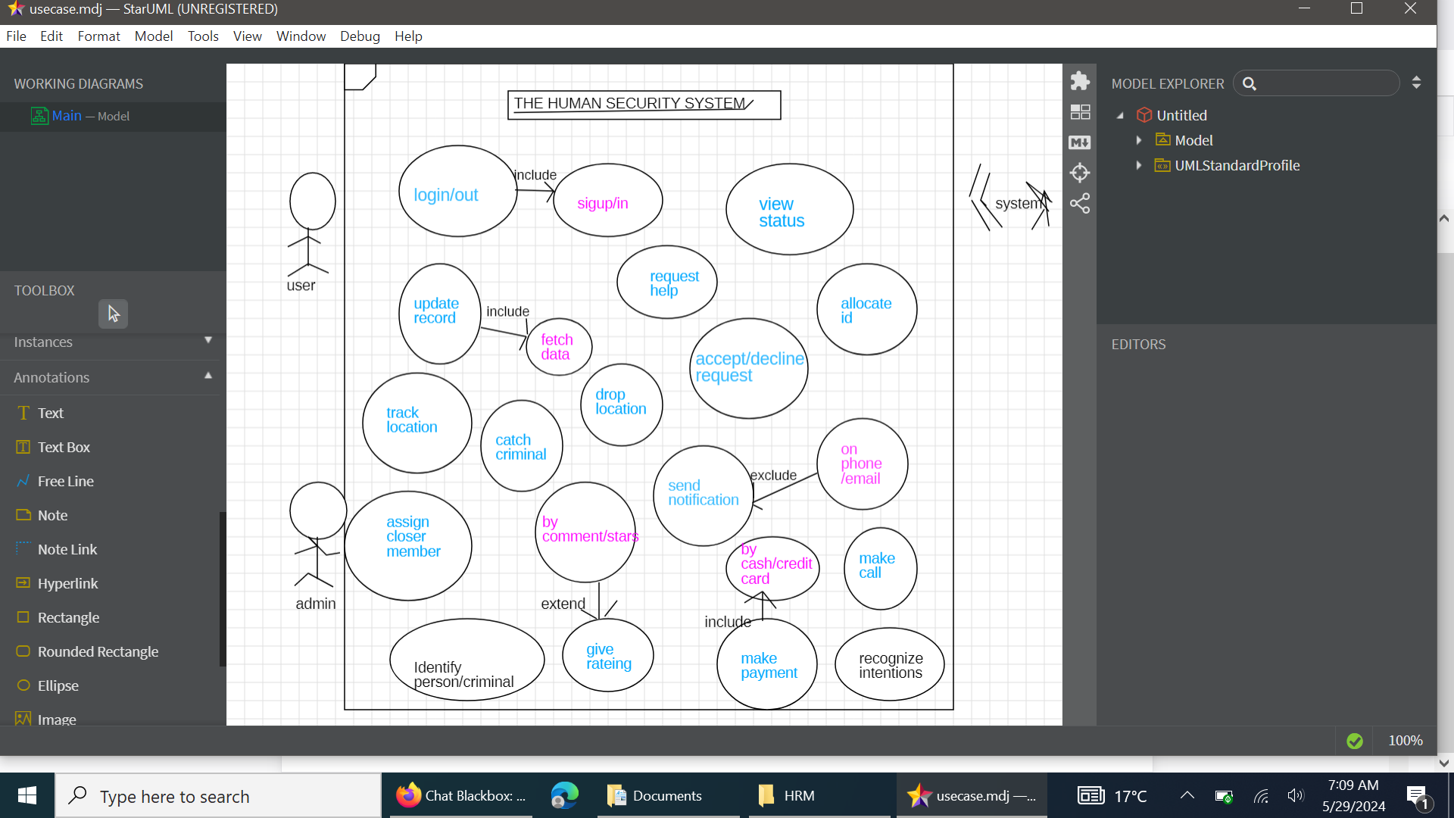

Slide 3
CODE : CALL FOR HELPER
DOMAIN LAYER In [2]:
from abc import ABC, abstractmethod
from typing import List, Dict
# User class representing a security system user
class User:
def __init__(self, username: str, password: str, role: str):
self.username = username
self.password = password # In a real system, use hashed passwords
self.role = role
# Interface for authentication
class IAuthenticator(ABC):
@abstractmethod
def authenticate(self, username: str, password: str) -> User:
pass
# Interface for access control
class IAccessControl(ABC):
@abstractmethod
def has_access(self, user: User, resource: str) -> bool:
pass
# Interface for incident reporting
class IIncidentReporter(ABC):
@abstractmethod
def report_incident(self, user: User, description: str) -> None:
pass
infrastructure layer In [3]:
# Concrete authentication class
class SimpleAuthenticator(IAuthenticator):
def __init__(self, users: List[User]):
self.users = {user.username: user for user in users}
def authenticate(self, username: str, password: str) -> User:
user = self.users.get(username)
if user and user.password == password:
return user
raise ValueError("Authentication failed.")
# Concrete access control class
class RoleBasedAccessControl(IAccessControl):
def has_access(self, user: User, resource: str) -> bool:
if user.role == "admin":
return True
if user.role == "employee" and resource in ["dashboard", "profile"]:
return True
return False
# Concrete incident reporting class
class IncidentLogger(IIncidentReporter):
def __init__(self):
self.incidents: List[Dict] = []
def report_incident(self, user: User, description: str) -> None:
incident = {"user": user.username, "description": description}
self.incidents.append(incident)
print(f"Incident reported by {user.username}: {description}")
application layer In [4]:
class SecuritySystem:
def __init__(self, authenticator: IAuthenticator, access_control: IAccessControl, incident_reporter: IIncidentRepo
rter):
self.authenticator = authenticator
self.access_control = access_control
self.incident_reporter = incident_reporter
def login(self, username: str, password: str) -> User:
return self.authenticator.authenticate(username, password)
def check_access(self, user: User, resource: str) -> bool:
return self.access_control.has_access(user, resource)
def report_incident(self, user: User, description: str) -> None:
self.incident_reporter.report_incident(user, description)
presentation layers In [5]:
def main():
users = [
User("admin", "adminpass", "admin"),
User("employee", "employeepass", "employee"),
]
authenticator = SimpleAuthenticator(users)
access_control = RoleBasedAccessControl()
incident_reporter = IncidentLogger()
security_system = SecuritySystem(authenticator, access_control, incident_reporter)
# User authentication and access control demonstration
try:
user = security_system.login("employee", "employeepass")
print(f"{user.username} logged in successfully.")
if security_system.check_access(user, "dashboard"):
print(f"{user.username} has access to the dashboard.")
else:
print(f"{user.username} does not have access to the dashboard.")
# Reporting an incident
security_system.report_incident(user, "Unauthorized access attempt detected.")
except ValueError as e:
print(e)
if __name__ == "__main__":
main()
output:
employee logged in successfully.
employee has access to the dashboard.
Incident reported by employee: Unauthorized access attempt detected.
T

